Slide 1

Email spam detection using blockchain
Under Supervision of
DR.kriti
School of Engineering and Technology
Team Members: Chanderhas (2401560014)
Deepti (2401560006)
Tannu (2401560038)

Slide 2

Problem Statement
In today's digital age, email remains a crucial medium for commu- -ication across individuals, businesses, and organizations. However, the growing influx of spam emails—unsolicited, irrelevant, or malicious messages—has become a major concern. These emails not only clutter inboxes but also pose serious risks such as phishing scams, fraudulent schemes, malware propagation, and identity theft.
Traditional rule-based filters are no longer sufficient to handle the complexity and evolving nature of spam content. Spammers continuously adapt their techniques to bypass basic filters, making manual or static detection methods ineffective. The lack of an efficient, accurate, and scalable solution to automatically identify and filter spam emails leads to productivity loss, increased security vulnerabilities, and reduced trust in email systems.
This rising challenge highlights the need to explore intelligent, adaptive methods to effectively detect and manage spam in real-time.

Slide 3
OBJECTIVES
Ensure Data Integrity Store email metadata on blockchain to prevent tampering and ensure trustworthy records.
Decentralize Spam Detection Distribute spam detection across a network to avoid single points of failure or control.
Enhance Trust and Transparency Make all spam detection actions verifiable by recording them on a transparent public ledger.
Prevent Spam Source Forgery Authenticate sender identities using blockchain to block spoofed or fake emails.
Enable Reputation-Based Filtering Track and store sender behavior on-chain to build reliable reputation scores.
Support Real-Time Detection and Updates Use smart contracts for automatic spam rule updates and fast decision-making.

Slide 4
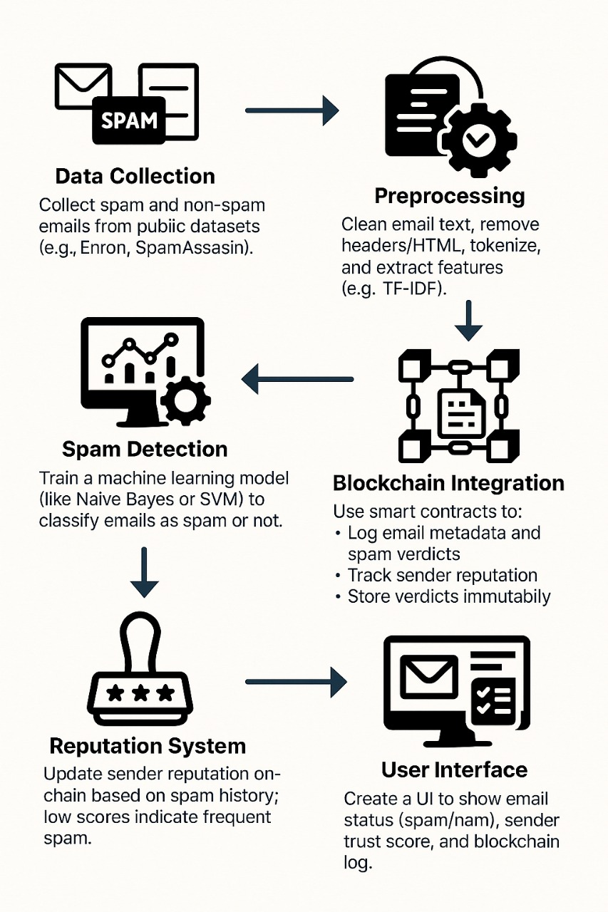
methodology

Slide 5
Key features of the project
Decentralized Spam Detection & Machine Learning: Distributes spam detection logic across a blockchain network and uses AI models to classify emails as spam or legitimate
Immutable Record-Keeping & Transparency: Stores email metadata and decisions on the blockchain, ensuring tamper-proof logs and providing an auditable trail of actions.
Trust and Reputation Management: Tracks and updates sender reputation based on past behavior, stored transparently on-chain.
Smart Contract Automation & Security: Automates spam detection actions (e.g., flagging) using smart contracts, while ensuring data privacy through encryption or hashing.
Community Reporting & Continual Learning: Enables decentralized spam reporting and allows for continuous updates and improvements to detection models through blockchain collaboration.

Slide 6
Conclusion & Future work
Conclusion:
The Email Spam Detection using Blockchain project uses machine learning for accurate spam classification and blockchain for secure, transparent, and immutable record-keeping. It ensures privacy by storing only hashed or encrypted email metadata. This solution provides a reliable and tamper-proof method to combat email spam.
Future Work:
Improve spam detection models with more training data.
Enhance scalability to handle large email volumes.
Integrate with more email platforms for wider adoption.
Boost privacy features with advanced encryption.
Encourage community collaboration for ongoing improvements..

